Slide 1

Continuous system
Dikesh katwal
Msc cs

Slide 2
Continuous System
Continuous System Simulation describes systematically and methodically how mathematical models of dynamic systems, usually described by sets of either ordinary or partial differential equations possibly coupled with algebraic equations, can be simulated on a digital computer.
Modern modeling and simulation environments relieve the occasional user from having to understand how simulation really works. Once a mathematical model of a process has been formulated, the modeling and simulation environment compiles and simulates the model, and curves of result trajectories appear magically on the user’s screen. Yet, magic has a tendency to fail, and it is then that the user must understand what went wrong, and why the model could not be simulated as expected.
Continuous Simulation refers to simulation approaches where a system is modeled with the help of variables that change continuously according to a set of differential equations

Slide 3
Classification of Continuous Simulation Language
Block oriented simulation languages are based on the methodology of analogue computers. The system must be expressed as a block diagram that defines the interconnection of functional units and their quantitative parameters. "Programming" means entering the interconnection of the blocks and their description. Then the user adds statements and/or directives that control the simulation. If the system is described as a set of equations, they must be converted to a block diagram. This conversion is a simple straightforward process. The typical blocks available in most continuous block oriented languages are integrators, limiters, delays, multipliers, hysteresis, constant values, adders, holders, gain (coefficient) and other.
Expression oriented continuous languages are based on writing expressions (equations) that represent the mathematical model. So the system simulated must be expressed by a set of equations. Then the user adds statements and/or directives that control the simulation. Some languages enable both block and expression based ways of system definition. Simulation control means selection of: the integration method (because some languages offer more), the integration step, the variables (outputs of blocks) that should be observed, the intervals for collecting data for printing and/or plotting, scaling of outputs (that may be also done automatically), duration of the simulation runs, number of repetitions and the way certain values are changed in them, etc

Slide 4
System Dynamics
System Dynamics is a computer-based mathematical modeling approach for strategy development and better decision making in complex systems. This approach uses computer-aided simulation methodology based on feedback systems theory which complements the other Systems Thinking approaches.
Also, it provides tools and methods to analyze dynamic systems. It can help solving problems arising in complex socio-economic systems (economic, social, managerial, political, public health or etc.) and as well as physical and/or natural systems where humans interact with them (physiological, environmental, ecological, or etc.)

Slide 5
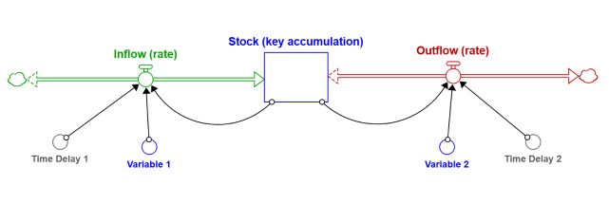

Slide 6
3.1 Continuous System Models
A continuous system is the system in which the activities of the main elements of the system cause smooth changes in the attributes of the entities of the system
On mathematical modeling, the attributes of the system are controlled by a continuous functions.
In such system, the relationships depicts the rates at which the attributes changes.
The continuous system is modeled using the differential equations.
The complex continuous system with non-linearity can be simulated by showing the application to models for linear differential equations to obtain constant coefficients and then generalize to more complex equations.

Slide 7
3.2 Differential Equations
The equation that consists of the higher order derivatives of the dependent variable is known as differential equations. - The differential equation is said to be linear if any of the dependent variables and its derivatives have power of one and are multiplied by the constant. Eg: M x’’ + D x’ + K x = K F(t) where, M, D and K are constants; F(t) is the input to the system depending upon the independent variable t; x’’ and x’ are second and first order derivatives of dependent variable x. - The differential equation is said to be non-linear if the dependent variable or any of its derivatives are raised to a power or are combined in other way like multiplication.
- The differential equation is said to be partial if more than one independent variables occur in a differential equation. - Eg: Equation of flow of heat in three dimensional body. It consists of four independent variables ( three dimensions and time ) and one dependent variable ( temperature ).

Slide 8
Differential Equations
The most physical and chemical process involves rate of change which requires differential equation for their mathematical description.
Since a differential coefficient can also represent a growth rate, continuous models can also be applied to problems of social or economic nature where there is a need to understand general effects of growth trend

Slide 9
Non-linear differential equations
A non-linear differential equation is a differential equation that is not a linear equation in the unknown function and its derivatives (the linearity or non-linearity in the arguments of the function are not considered here). There are very few methods of solving nonlinear differential equations exactly; those that are known typically depend on the equation having particular symmetries. Nonlinear differential equations can exhibit very complicated behaviour over extended time intervals, characteristic of chaos. Even the fundamental questions of existence, uniqueness, and extendability of solutions for nonlinear differential equations, and well-posedness of initial and boundary value problems for nonlinear PDEs are hard problems and their resolution in special cases is considered to be a significant advance in the mathematical theory (cf. Navier–Stokes existence and smoothness). However, if the differential equation is a correctly formulated representation of a meaningful physical process, then one expects it to have a solution.^{[11]}
Linear differential equations frequently appear as approximations to nonlinear equations. These approximations are only valid under restricted conditions. For example, the harmonic oscillator equation is an approximation to the nonlinear pendulum equation that is valid for small amplitude oscillations

Slide 10
Partial differential equations
A partial differential equation (PDE) is a differential equation that contains unknown multivariable functions and their partial derivatives. (This is in contrast to ordinary differential equations, which deal with functions of a single variable and their derivatives.) PDEs are used to formulate problems involving functions of several variables, and are either solved in closed form, or used to create a relevant computer model.
PDEs can be used to describe a wide variety of phenomena in nature such as sound, heat, electrostatics, electrodynamics, fluid flow, elasticity, or quantum mechanics. These seemingly distinct physical phenomena can be formalized similarly in terms of PDEs. Just as ordinary differential equations often model one-dimensional dynamical systems, partial differential equations often model multidimensional systems. Stochastic partial differential equations generalize partial differential equations for modeling randomness

Slide 11
3.3 Analog computer
The most widely used form of analog computer is the electronic analog computer, based on the use of high gain dc (direct current) amplifiers, called operational amplifiers.
Voltages in the computer are equated to mathematical variables, and the operational amplifiers can add and integrate the voltages.
With appropriate circuits, an amplifier can be made to add several input voltages, each representing a variable of the model, to produce a voltage representing the sum of the input variables

Slide 12
The core mathematical operations used in an electric analog computer are:
•Addition
•Integration with respect to time
•Inversion
•Multiplication
•Exponentiation
•Logarithm
•Division
•Differentiation with respect to time is not frequently used,
and in practice is avoided by redefining the problem when
possible.

Slide 13
Components of analog computers
Different scale factors can be used on the inputs to represent coefficients of the model equations.
•Amplifiers that sums different terms are called summers.
•Another circuit arrangement produces an integrator for which the output is the integral with respect to time of a single input voltage or the sum of several input voltages.
•All voltages can be positive or negative to correspond to the sign of the variable represented
To satisfy the equations of the model, it is sometimes necessary to use a sign inverter, which is an amplifier designed to cause the output to reverse the sign of the input

Slide 14

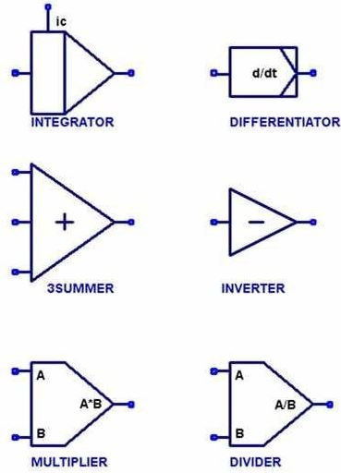




Adder
Differentiator
Integrator
Subtracter
Scale factor

Slide 15
Advantages
•The analog computer do not suffer quantization noise but are limited by analog noise.
•Analog computers are widely used in scientific and industrial applications where digital computers lack sufficient performance, like flight computer in aircrafts, for teaching control system in universities.
•The analog representation of a system is often more natural as it directly reflects the structure of system; thus simplifying both the setting up of a simulation and interpretation of results
•The analog computer is faster than digital under certain circumstances as it could solve many equations in simultaneous manner while digital computer can be working on one equation at a time

Slide 16
Disadvantages
•An analog computer have limited accuracy and dedication to one particular problem, may not be significant.
•Electronic analog computer have limited accuracy due to following reasons-•It is difficult to carry the accuracy of measuring a voltage beyond a certain point•A number of assumptions are made in deriving relationship for operational amplifiers, none of which is strictly true.
•The assumption that there should be zero output voltage for zero input voltage is difficult to achieve.
•Operational amplifiers have limited dynamic range of outputs, so scale factor must be introduced to keep within range.

Slide 17
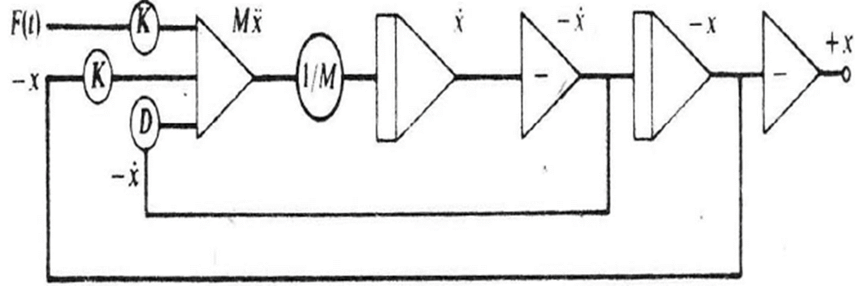
3.4 Analog method
The general method by which analog computers are applied can be demonstrated using second order differential equation.
M x" + D x' + K x = K F(t)
Solving the equation for the highest order derivate gives,
M x" = K F(t) – D x' - K x
Suppose a variable representing the input F(t) is supplied, assume there exist variables representing -x and -x'. These three variables can be scaled and added to produce Mx". Integrating it with a scale factor 1/M produces X'. Changing sign produces -x', further integrating produces -x, a further sign inverter is included to produce +x as output

Slide 18
The symbols used in the figure are standard symbols for drawing block diagrams representing analog computer arrangements.
 The circles indicate scale factors applied to the variables.
 The triangular symbol at the left of the figure represents the operation of adding variables.
 The triangular symbol with a vertical bar represents an integration, and the one containing a minus sign is a sign change
1. What do you understand by analog method of system simulation? Explain it with suitable example.

Slide 19
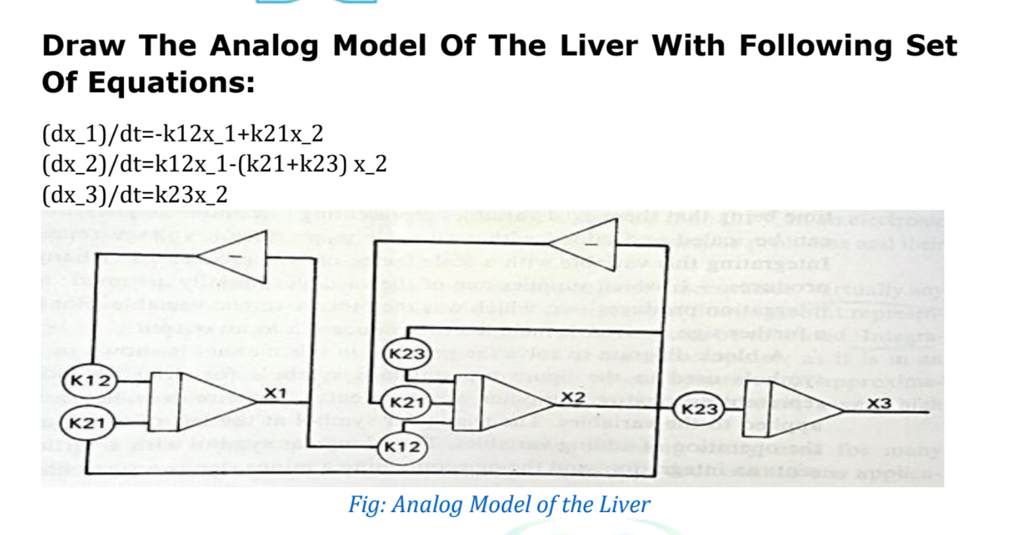

Slide 20
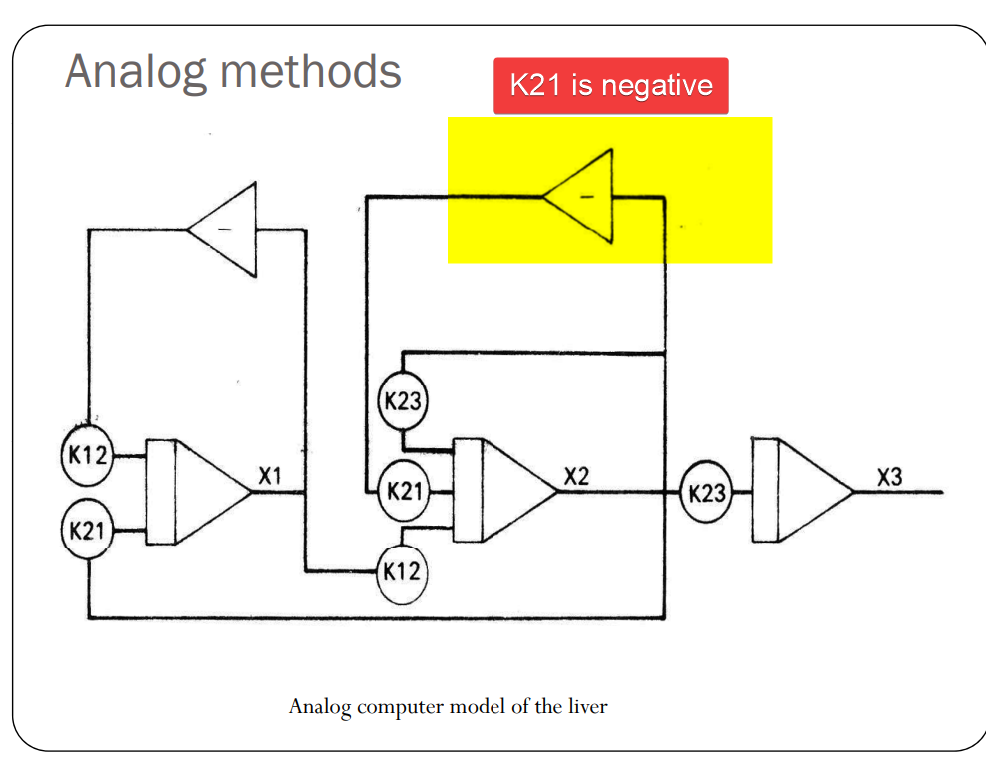

Slide 21
3.5Hybrid computers
Hybrid computers are computers that exhibit features of analog computers and digital computers. The digital component normally serves as the controller and provides logical and numerical operations, while the analog component often serves as a solver of differential equations and other mathematically complex problems.
This device is designed to work or process data in the digital form, hence, it changes received analog signals first, then processes digital data. Example: Computer measuring and displaying the heartbeat of patient

Slide 22
Hybrid simulation
is a simulation technique that combines both analog and digital simulation methods to model complex real-world systems. The analog part handles continuous variables such as speed, temperature, pressure, or motion, while the digital part handles discrete events, logic, and control operations. Both parts work together in a single system and exchange data using interface devices like ADC (Analog-to-Digital Converter) and DAC (Digital-to-Analog Converter). This makes it possible to simulate systems that involve both continuous change and step-by-step decision-making.
Hybrid simulation is widely used in complex fields where pure analog or pure digital simulation is not enough, such as flight simulation, missile guidance systems, robotics, weather forecasting, and industrial process control. It provides better accuracy and real-time performance for complex systems. However, it is more complex and expensive to design because it requires proper coordination between analog and digital components.
For example, in a temperature control system, the temperature changes continuously, but the controller switches the heater ON or OFF based on fixed limits (18°C and 25°C). This shows how both analog and digital systems work together in hybrid simulation.

Slide 23
Digital analog simulator
To avoid the disadvantages of analog computers,many digital computer programming languages have been written to produce digital-analog simulators. They allow a continuous model to be. programmed on a digital computer in essentially the same way as it is solved on an analog computer.The languages contain macro-instructions thatcarry out the action of adders,integrators,and sign changers.
A program is written to" link together these macro-instructions, in essentially the sane marnner as operational amplifiers are connected in analog computers.
More powerful techniques of applying digital computers to thsimulation of continuous systems have been developed. As aresult,digital-analog simulators are not now in extensive use.

Slide 24
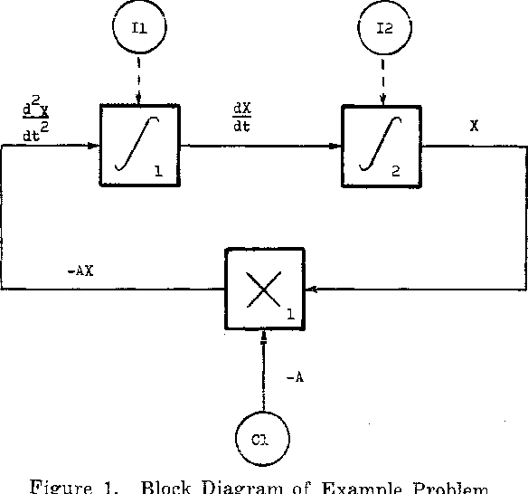

Slide 25
Serial Chase Problem
A Serial Chase Problem in Computer Simulation refers to a situation where one moving object continuously follows another moving object along a path. It is commonly studied in simulation and modeling, operations research, and traffic/military movement systems.
In a serial chase:
Object A follows object B
Object B may follow object C
This continues in a chain (serially)
Each follower changes its movement based on the object ahead
Real-Life Examples
Cars following each other in traffic
Missiles tracking aircraft
Police chasing a thief
Animals hunting prey
Robots following another robot

Slide 26
problem
Three objects A, B, and C are moving in a straight line.
Speed of A = 6 m/s
Speed of B = 4 m/s
Speed of C = 2 m/s
Initial distance between A and B = 40 m
Initial distance between B and C = 60 m
Find:Time when A catches B,
Time when B catches C (after being caught by A, assume B continues same motion)
A catches B
Relative speed​=VA​−VB​=6−4=2 m/s
Time:T=40/2​=20 sec

Slide 27
Feedback Systems
•In a feedback system, a portion of the system output is fed back into the system, thus introducing a level of dependencies among input and output signals in the system.
•With the use of feedback in communication systems, satisfactory response and robust performance can generally be achieved
•In a system with feedback, also known as a closed-loop control system, the past output may influence the present or future outputs.
•Most physical systems embody some form of feedback.
•In a system with feedback, a closed sequence of cause-and-effect relations exists between system variables.
•There are two types of feedback systems. In a positive feedback system, the feedback is used to increase the input signal level, thus generally making the system unstable.
•Positive feedback is widely used in oscillatory circuits such as oscillators and timing circuits.
In a negative feedback system, the feedback is used to decrease the input signal level to ensure system stability.

Slide 28
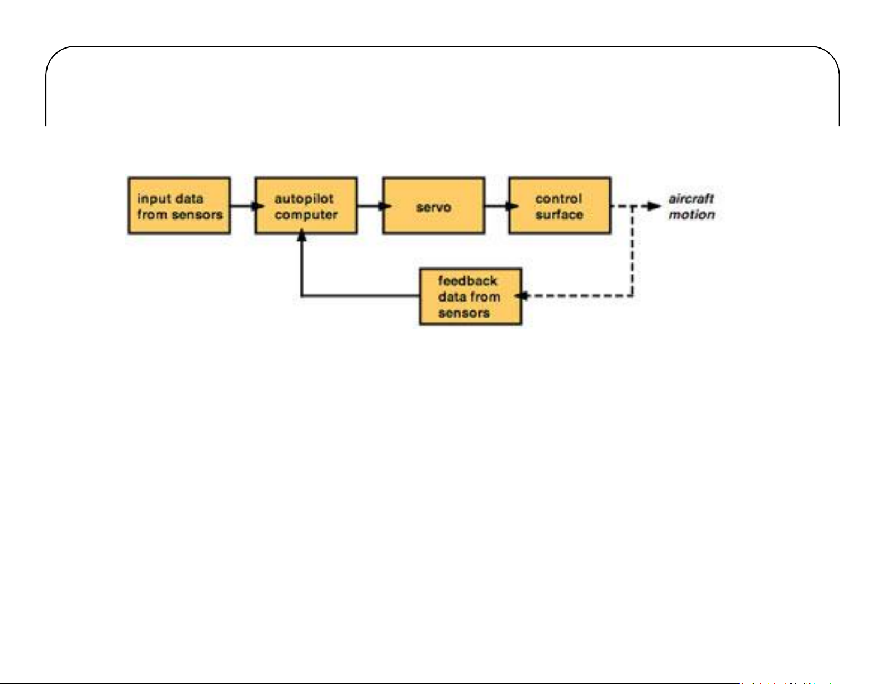
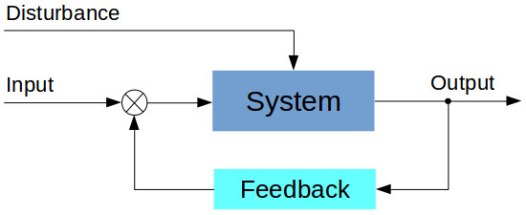

Slide 29
Interactive systems
Interactive systems are computer systems characterized by significant amounts of interaction between humans and the computer. Editors, CAD-CAM (Computer Aided Design-Computer Aided Manufacture) systems, and data entry systems are all computer systems involving a high degree of human-computer interaction. Games and simulations are interactive systems. Web browsers and Integrated Development Environments (IDEs) are also examples of very complex interactive systems
To improve efficiency and effectiveness of computer software, programmers and designers not only need a good knowledge of programming languages, but a better understanding of human information processing capabilities as well.
They need to know how people perceive screen colors, why and how to construct unambiguous icons, what common patterns or errors occur on the part of users, and how user effectiveness is related to the various mental models of systems people possess

Slide 30
Real time simulation
Real time simulation is reproducing the behavior of a physical system through running its computer-based model at the same rate as actual wall clock time. In other words, in real time simulation, when the simulation clock reaches a certain time, the same amount of time has passed in the real world.
For example, if a process takes 1 second to finish in the real world, the simulation would take 1 second as well. Real time simulation is typically used for high-speed simulations, closed-loop testing of protection and control equipment, and generally all “What-if” analyses. Real time simulation is actually simulating a system, which could realistically respond to its environment, when the inputs/outputs of the simulation are synchronous with the real world
A fire drill is an example of a simulation. It reenacts the real world scenario of a fire in a building or an environment with the purpose of teaching appropriate actions in the event a real fire is encountered. It is also used to teach a skill for example, in teaching how to perform cardiopulmonary resuscitation (CPR) or deliver a baby. , science laboratory experiments, simulations used in movies, sports, and video games.

Slide 31
Predator pray model
It is also called the parasite-host model. An environment consists of two population i.e.predator and prey.It is also a mathematical model.The prey is passive but the predatordepends on the prey for their source of food.
Let,
x(t)= number of prey population at time t.
y(t)= number of predator population at time t.
r.x(t) =rate of growth of prey for some +ve‘r’,where r= natural birth and deathrate.
Because of the interction between predator and prey,it will be reasonable to assume
that the death rate of prey is proportional to the product of two population size x(t).y(t).

Slide 32
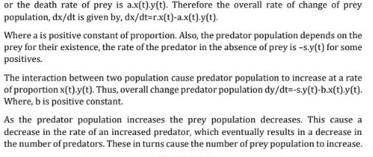
Predator pray model

Slide 33
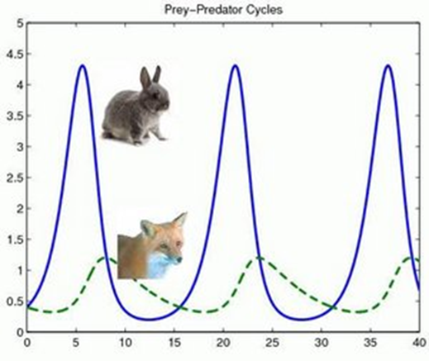

Slide 34
Steps of simulation
1.Problem formulation
Clearly state the problem.
2. Setting of objectives and overall project plan
How we should approach the problem.
3. Model conceptualization
Establish a reasonable model.
4. Data collection
Collect the data necessary to run the simulation (such as arrival rate, arrival process, service discipline, service rate etc.).
5. Model translation
Convert the model into a programming language.
6. Verification
Verify the model by checking if the program works properly. Use common sense.
7. Validation
Check if the system accurately represent the real system.
8. Experimental design
How many runs? For how long? What kind of input variations?

